Slide 1


Git
Workflows
itechart.com

Slide 2
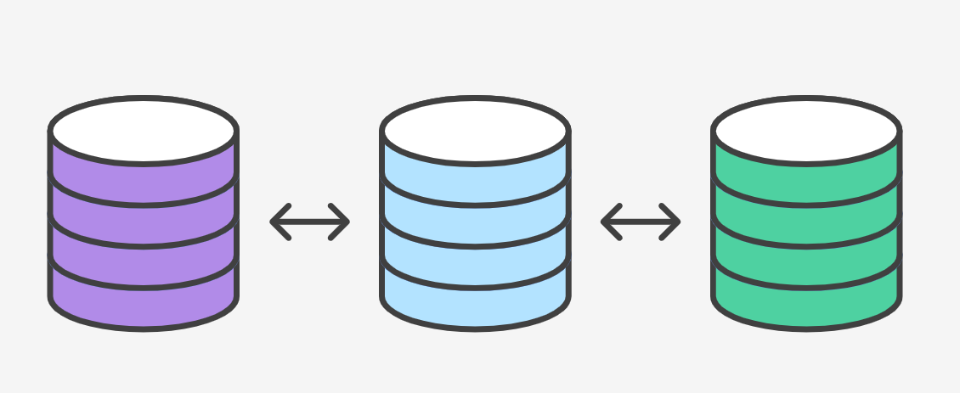
Workflow
Workflow - a recipe or recommendation for how to use Git to accomplish work in a consistent and productive manner.

Slide 3
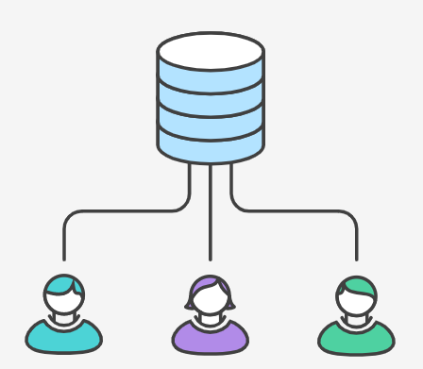
Centrilized Workflow
• Central repository is a single point-of-entry for all changes to the project.
• Each developer work independently of all other changes to a project, but all changes are pushed into the single branch master.

Slide 4
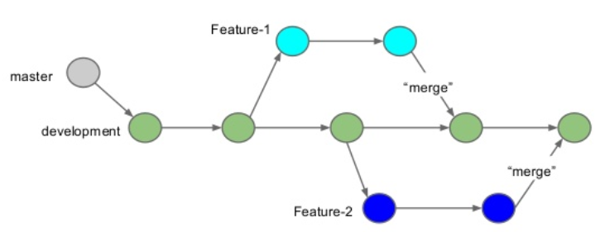
Feature Branch Workflow
All feature development should take place in a dedicated branch.
• Encapsulates features
• Master only contains tested code
• PRs

Slide 5

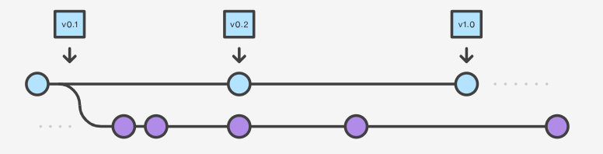
Gitflow Workflow
• Gitflow is ideally suited for projects that have a scheduled release cycle.
• In addition to feature branches, it uses individual branches for preparing, maintaining, and recording releases.

Slide 6
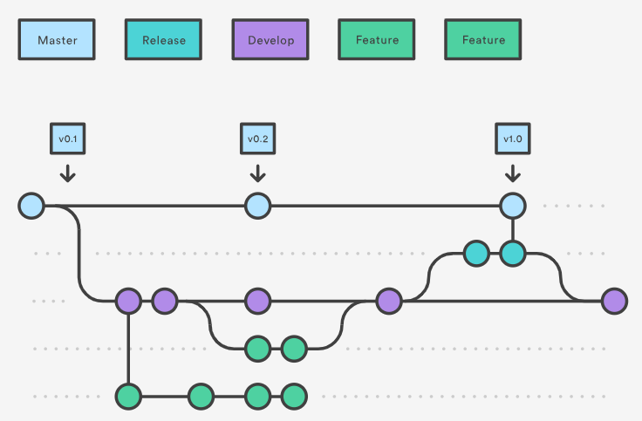
Gitflow Workflow

Slide 7
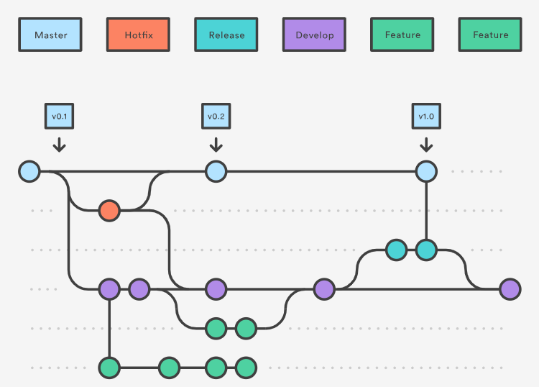
Hotfix Branches

Slide 8
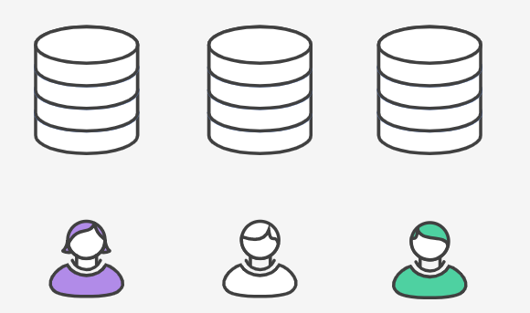
Forking Workflow
• It gives every developer their own server-side repository.
• Forked repositories are created using git clone.
• It is most often seen in public open-source projects.

Slide 9
Clarifying the reason for the change
• Ticket number in PR title, all commit messages and branch
• PR describes technical implementation (if complex)
• PR explains any considerations and pre-conditions
• PR shows feature result (screen on UI, format of API response)
• PR is small enough to review
• Commits and PRs don’t contain unrelated changes

Slide 10
Keeping history clean
• Using rebases and squash merges (rebase + fast forward)
• Checking commits with pre-commit/pre-push hooks
• Re-checking code even after simple merges

